Slide 1
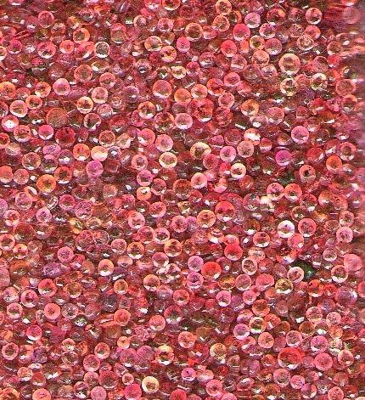
Object-oriented Programming with Ruby
Robert Batzinger
CSCI A-201
Spring 2009

Slide 2
Built-in Class Libraries:
Building with classes that come with Ruby

Slide 3
Why use class libraries?
Allow you to build on the work of others resulting in significant savings in time and effort
Provides a standard for interfacing your applications with the underlying operating system
Imposes a structure that can be optimized independent of your local efforts.
Creates a standard platform for creating solutions that will work on a wide range of computers and operating systems

Slide 4
When using class libraries, be sure to …
Identify if the class is preloaded or requires a method call to load it or its parent class.
Note what methods and attributes are inherited by the parent class.
Determine which methods are class methods and which ones are instance methods.
Provide parameters in the required class, order and value range.
Use utility methods to probe and test the use of methods supplied.

Slide 5
Identify if the class is preloaded or requires a method call to load it or its parent class.

Slide 6
Note what methods and attributes are inherited by the parent class.

Slide 7
Determine which methods are class methods and which ones are instance methods.

Slide 8
Provide parameters in the required class, order and value range.

Slide 9
Use utility methods to probe and test the use of methods supplied.

Slide 10
The String Class:
Manipulating textual data

Slide 11
String methods:
% * + << <=> == =~ [ ] [ ]= capitalize capitalize! casecmp center chomp chomp! chop chop! concat count crypt delete delete! downcase downcase! dump each each_byte each_char each_line empty? eql? gsub gsub! hex include? index insert inspect intern is_binary_data? is_complex_yaml? iseuc issjis isutf8 jcount jlength jsize length ljust lstrip lstrip! match next next! oct replace reverse reverse! rindex rjust rstrip rstrip! scan scanf size slice slice! split squeeze squeeze! strip strip! sub sub! succ succ! sum swapcase swapcase! to_f to_i to_s to_str to_sym to_yaml toeuc tojis tosjis toutf16 toutf8 tr tr! tr_s tr_s! unpack upcase upcase! upto yaml_new

Slide 12
Whitespace Trimming
chomp / chomp!
chop chop!
lstrip lstrip!
rstrip rstrip!
strip strip!
_ _Smile _ _
-----------------------------
_ _Smile _ _ chomp
_ _Smile _ chop
_ _Smile rstrip
Smile _ _ lstrip
Smile strip

Slide 13
Whitespace padding
center
ljust
rjust
Smile
----------------------------
_ _ Smile _ _
Smile _ _ _ _
_ _ _ _ Smile

Slide 14
Conversion to another data type
hex
oct
to_f
to_i
to_yaml
’17’
------------------------------
’17’.hex 23
‘17’.oct 17
‘17’.to_f 17.0
‘17’.to_i 17
‘17’.to_yaml ”17”

Slide 15
Iterators
each
each_byte
each_char
each_line
upto
“ab\ncd\n”.each_line{}
“ab\ncd\n”.each{}
ab
cd
“ab\ncd\n”. each_byte {}
“ab\ncd\n”. each_char {}
a b \n c d \n
‘a’.upto(‘d’){}
a b c d

Slide 16
Size and position
[ ]
[ ]=
count
index
length
size
rindex
reverse
reverse!
a = ‘abc’
-------------------------------
a[1] b
a[1] = ‘xyz’ axyzc
a.index(‘c’) 2
a.size 3
a.length 3
a.count 3
a.reverse cba

Slide 17
Logical expressions and predicates
<=>
==
Casecmp
empty?
eql?
include?
is_binary_data?

Slide 18
Search and replace
delete
gsub
match
sub
tr
replace
irb> s='hello'
=> "hello"
irb> s.delete('l')
=> "heo"
irb> s.gsub('l','t')
=> "hetto"
irb> s.tr('lo','ta')
=> "hetta"
irb> s.sub('l','t')
"hetlo“
irb> s.match('t')
=> nil
irb> s.match(‘e')
=> #<MatchData:0x43ac380>
irb> s.replace('good-bye')
=> "good-bye"

Slide 19
String variants
next
squeeze
crypt
irb> 'a'.next
=> "b"
irb> 'a1'.next
"a2“
irb> 'bookkeeper'.squeeze
"bokeper"
irb> 'a1'.crypt('aa')
=> "aaFAe5xAw.VQ."
irb> 'a1'.crypt('bb')
=> "bblzKfkMF.bzM"

Slide 20
Breaking a string
split
match
=~
scan
slice
s = ’10 Jan 2009’
irb> s = '10 Jan 2009'
=> "10 Jan 2009"
irb> s.split(' ')
=> ["10", "Jan", "2009"]
Irb> s.match('Jan')
=> #<MatchData:0x43a6d2c>
irb> s.match('Dec')
=> nil
irb> s =~ /Jan/
=> 3
irb> s.scan(/\d* \S* \d*/)
=> ["10 Jan 2009"]
Irb> s.scan(/(\d*) (\S*) (\d*)/)
[["10", "Jan", "2009"]]
irb> s.slice(3,3)
"Jan“

Slide 21
おわり The end

